Slide 1

Welcome Let's make your efforts meaningful!
By Starsplusplus

Slide 2
What is significant impact?
Impact quantitatively
Qualitative impact
Collect and analyze data
Reflects the results and effectiveness
Informed decisions based on the data

Slide 3
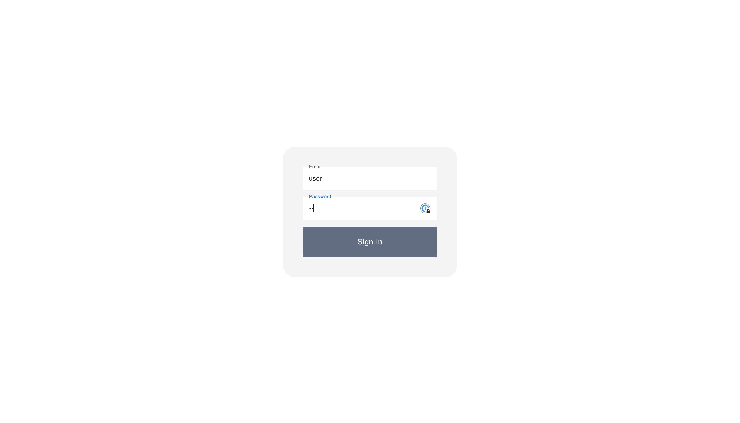
Signifimpact – impact tracker

Slide 4
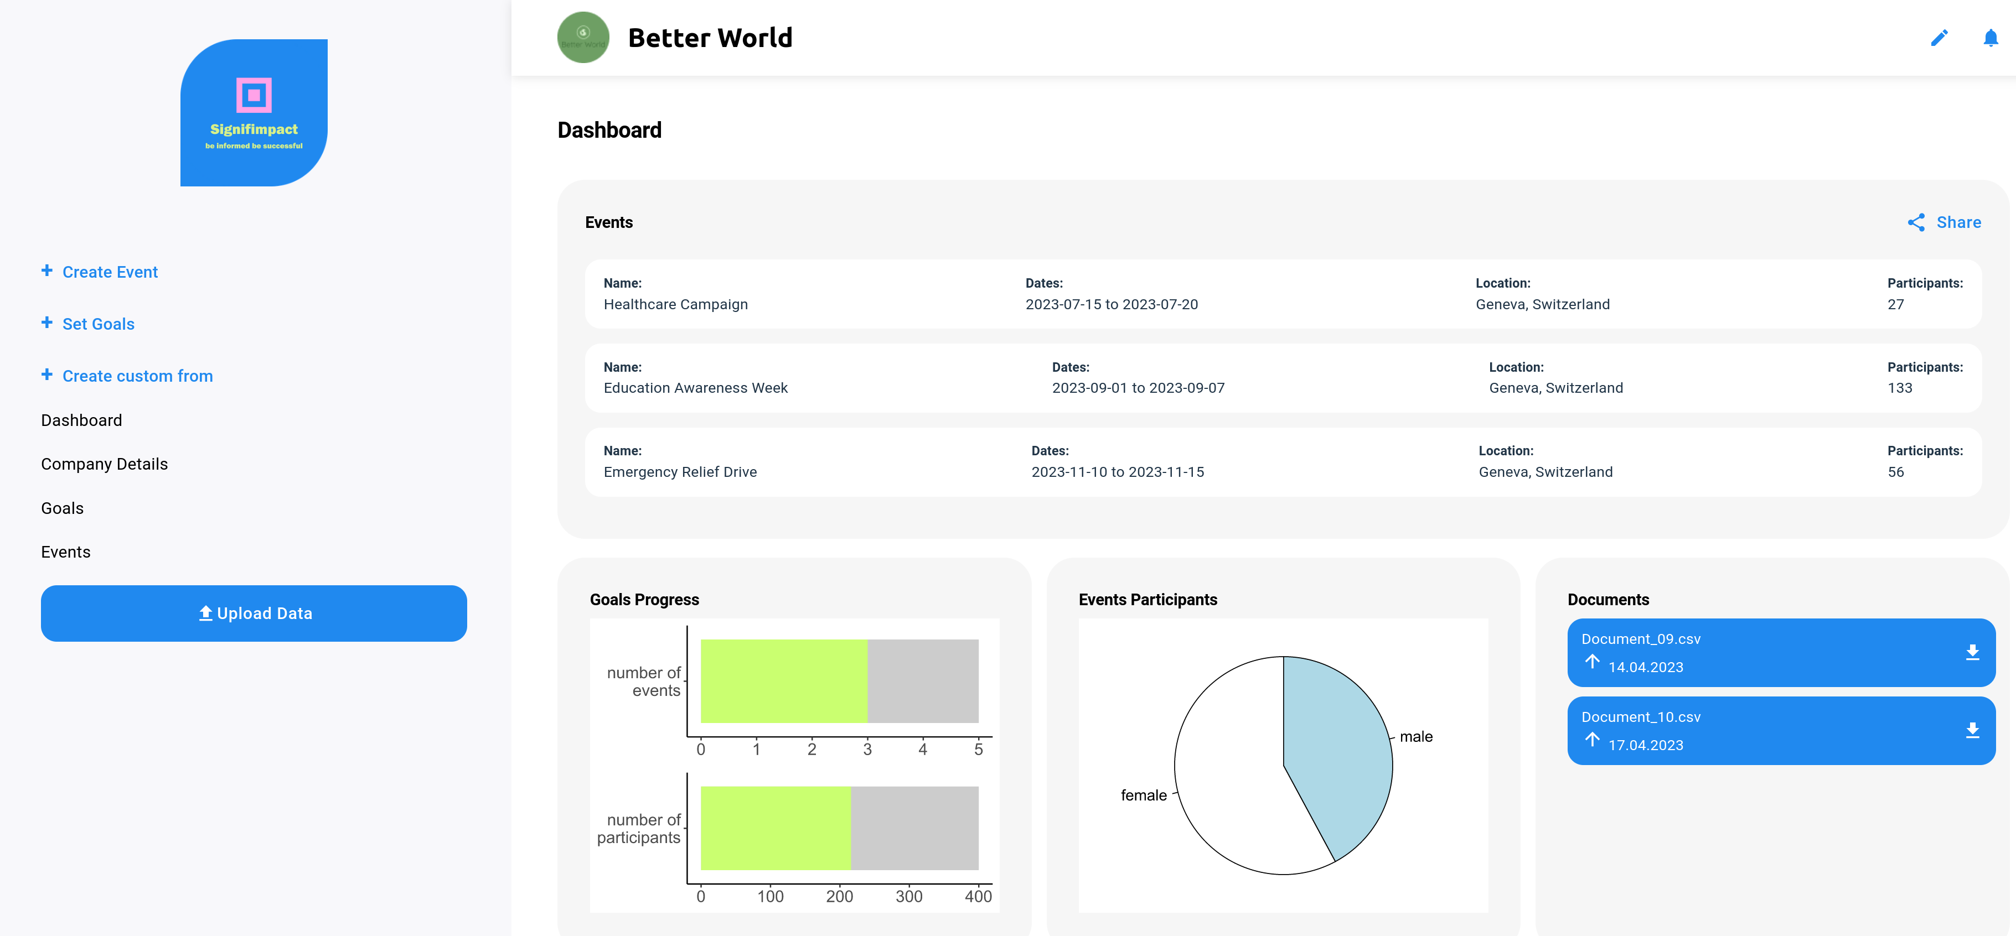
The Dashboard

Slide 5


Highlights
Our stack:
Javascript frontend (React framework)
+
Python backend (FastAPI)
Streamline your impact reporting
Data-driven decision making
User-friendly impact
1
2
3

Slide 6
Coming soon...
Project Level Reporting 📒
Data Security and Protection 🔐
Dynamic Data Visualization 📊
AI powered Reporting and Analyzing Tools 📃📈

Slide 7

Thank you
The Starsplusplus team

